Slide 1
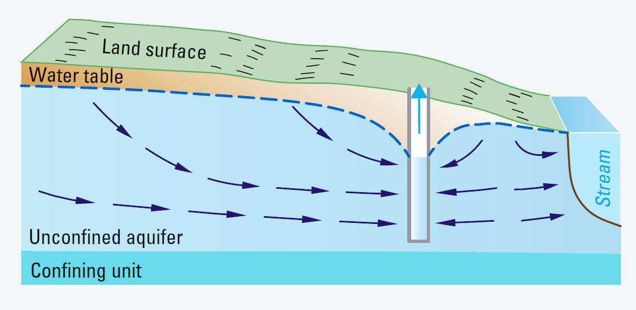
GroMore Project
Scenarios 1 and 2
Group 1 - Amanda, Justin, Tesfa, Vivek

Slide 2
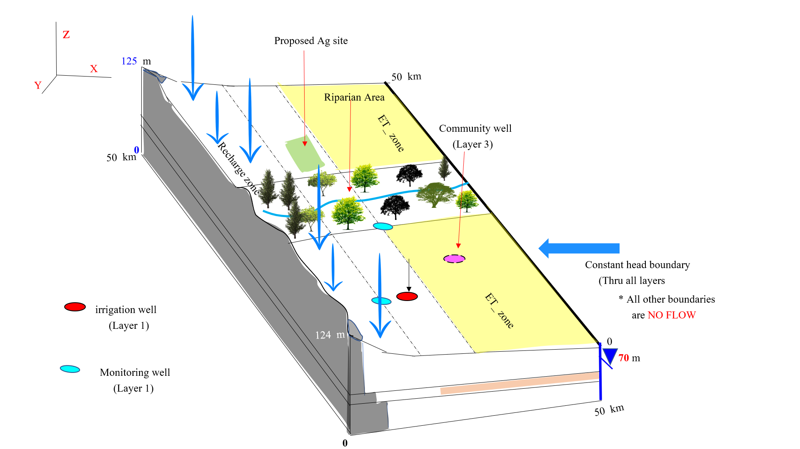

Slide 3
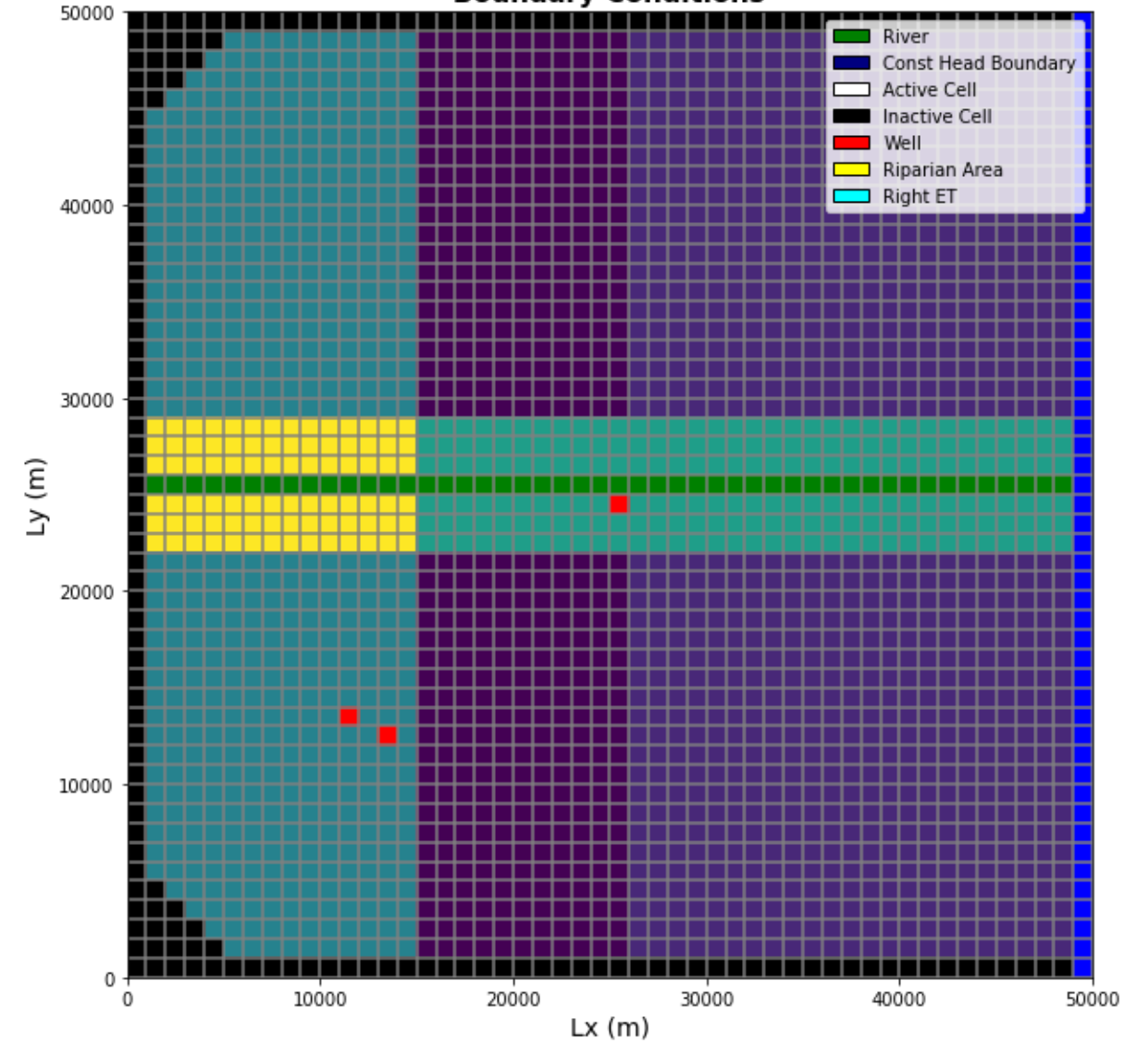
Domain Layout
For Scenario 1 and 2
Conditions
Irrigation well not pumping
Town well not pumping

Slide 4
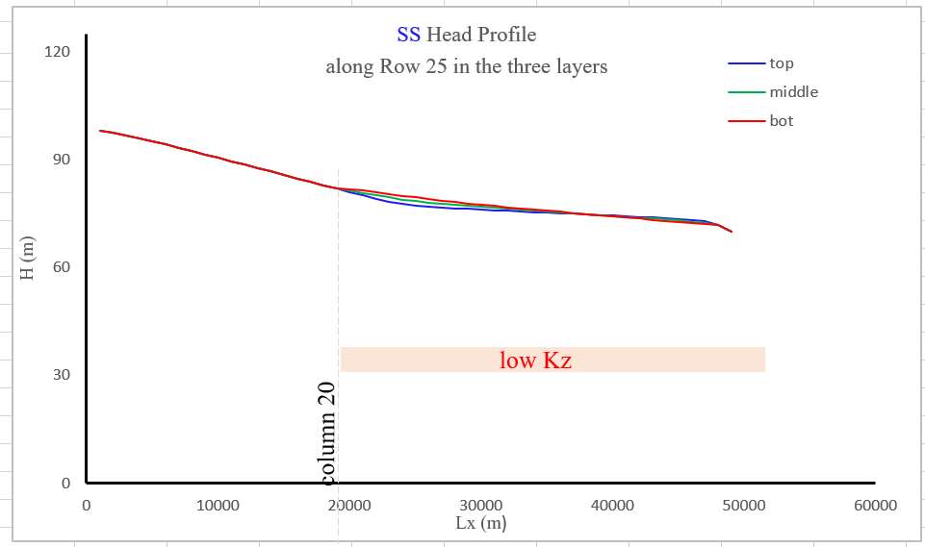
Head profile along river row

Slide 5
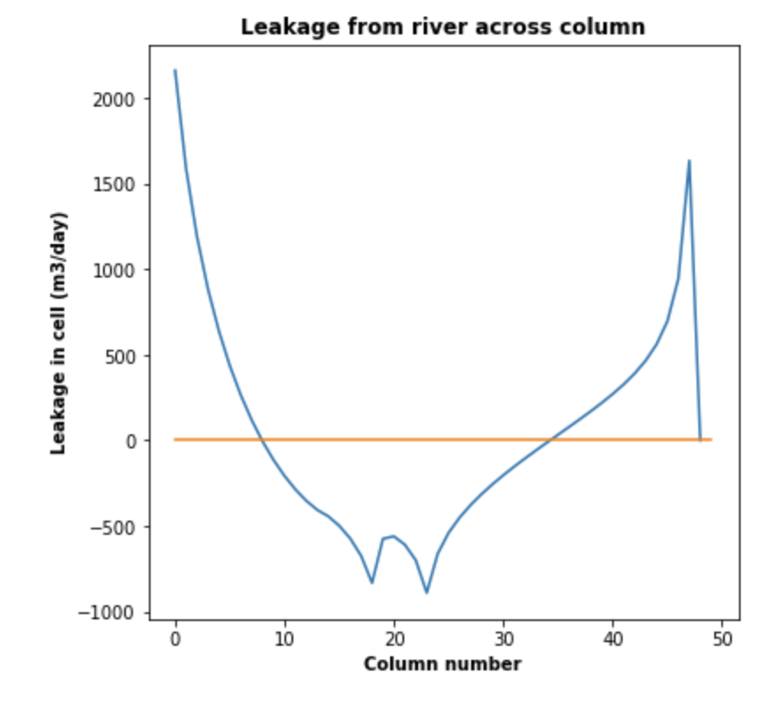
River Leakage
Net flux from the stream to the groundwater = 2360 m3/day

Slide 6
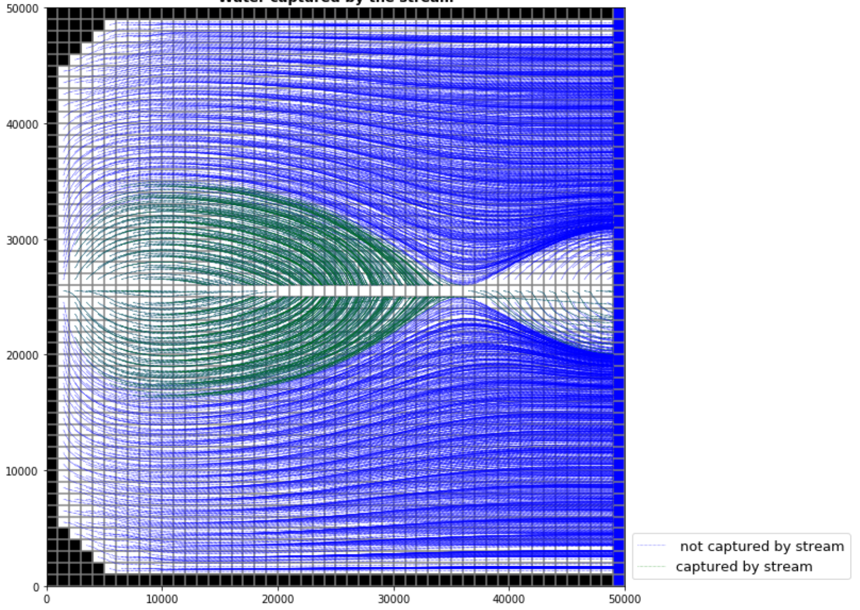
Source of the Water Coming into the Stream
Stream gaining in the middle stretch due to:
High recharge on the left
High ET on the right
Right boundary as a strong sink
Option of ‘Weak sink' with a specified only available in MODPATH 5

Slide 7
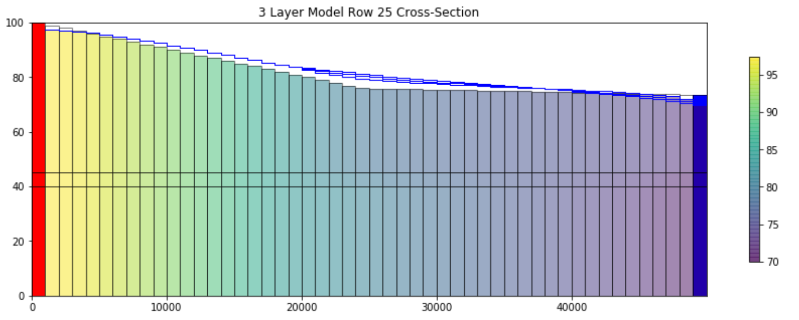
Water Head Levels
At Monitoring Well 1 (Col 11):
Head = 78.39 m
Head at Monitoring Well 2 (Col 25):
Head = 91.14 m
Head at Community Well 1 (Col 37):
Head = 75.92 m

Slide 8
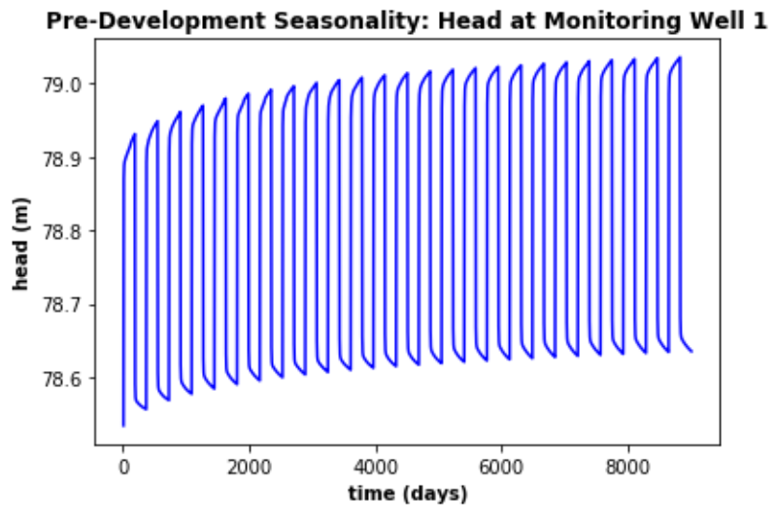
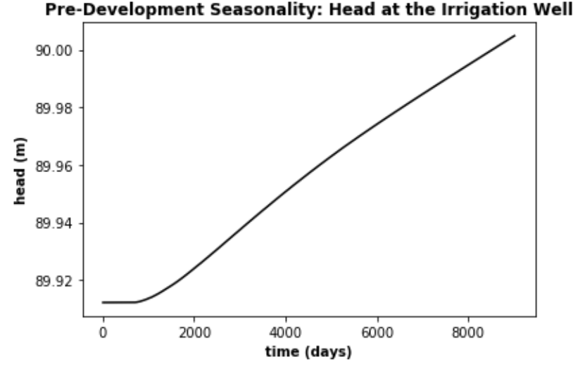
Scenario 2 - Heads at Monitoring Wells - 25 years

Slide 9
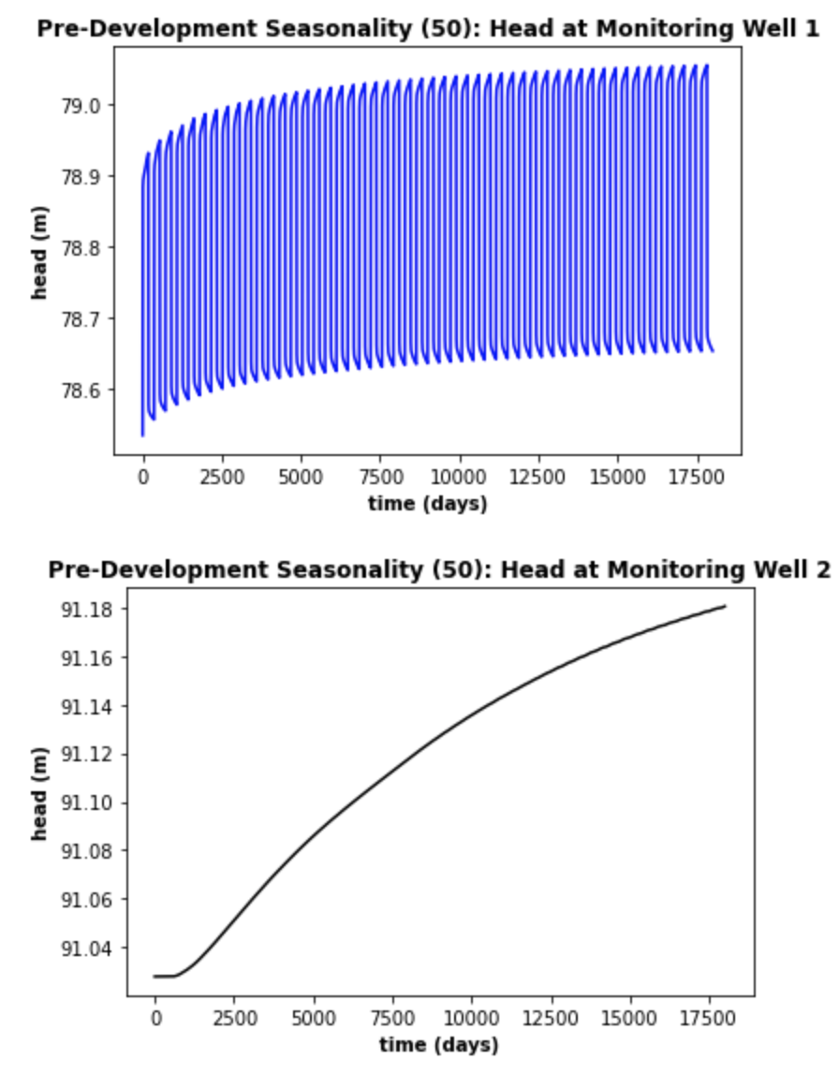
Heads at Monitoring Wells - 50 years

Slide 10
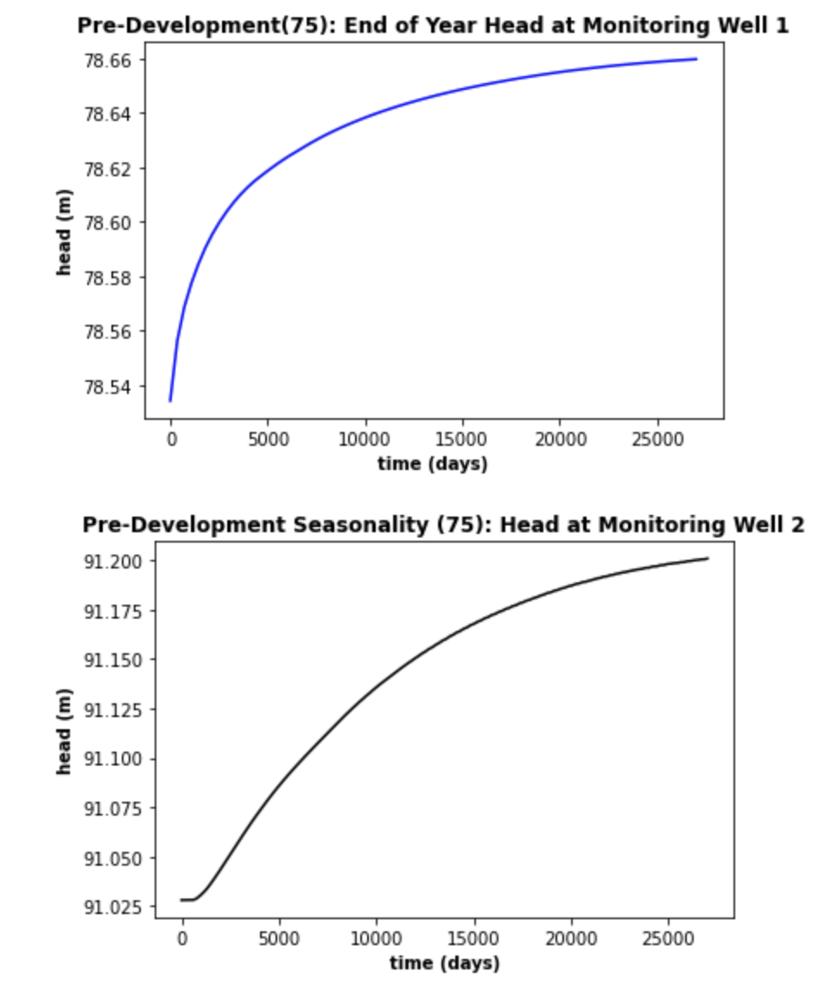
Heads at Monitoring Wells - 75 years

